Slide 1
Introduction to DB
By. Ahmed Mohamed Samir
ahmedmohamedmvp@gmail.com

Slide 2
PART1: DB IN GENERAL

Slide 3
DB Life Cycle
make requirement doc [System analysis]
DB design → ERD [DB Designer]
Mapping: DB Schema [DB Designer]
DB implementation to create Physical DB [DB Developer]
Testing
Software development life cycle
Requirement Gathering: determine requirement specifications and get them approved by stakeholders
System Design: Determine DB Provider, Design DB, Design User interface, system Architecture
Implementation: ( Convert design specifications into source code )
Testing
Deployment
Maintenance

Slide 4
DB Users
DB Administrator → configuration of DB like storing , backup
System Analyst → make requirement documents from user needs
DB designer → make the diagrams like ERD, Schema
DB developer → make the DB
application programmer → interface

Slide 5
file based system drawbacks
no sharing for data: each application has a copy of data in the form of separated & isolated files
data redundancy: duplication of data
Difficulty in Data Access: scanning all file to search on specific data
no security: no permission
no relationship: accept invalid data
no constrains such as I want to say age between 10 50
No database integrity because there is no constrains: such as
not accept dep_id not exist
not accept duplicate Id of table
no data quality → no data types
Different incompatible file format: [delimited file , fixed width file]
manual backup_restore

Slide 6
DB system
there are relationship
DB sharing: each developer connect to the DB server
security
data quality: DT
constrains for example salary between 2500 3600
DB integrity

Slide 7
What is the difference between database & DBMS & Database System
Database: it’s an organized collection of structured data in the form of related table
DBMS: Tool to help us to manage control DB like SQL, Oracle
Database System: DBMS, database itself, application

Slide 8
ERD (Entity Relationship diagram)
convert requirements document into diagrams
consist of: Entities, Attributes, Relationships
ERD is a metadata [description of data]
it can be more than 1 relationship between entities if we have more than 1 verbs, each verb has a different meaning

Slide 9
ERD (ENTITIES)
Entities
Entities are objects or things in the miniworld
the Entity name format in ERD is capitalized like EMPLOYEE, DEPARTMENT
Divided into
strong [regular] entity: most of entities are strong, its existence not depend on another entity like course, student
weak entity:
its existence based on parent entity
relies on the existence of a strong entity. If the strong entity is deleted, the weak entity is also deleted
for example, like transaction & account if account is deleted , its transactions will be deleted also
the primary key of a weak entity is a composite key that includes the primary key of the strong entity and the partial key

Slide 10
ERD (Attributes)
Attributes are properties used to describe an entity: like an EMPLOYEE entity may have the attributes SSN, Address, Gender , Birthdate → the first letter is capital
Simple attribute : not calculated , has one value ,
Composite attribute : for example, Name(FirstName, MiddleName, LastName) in schema each on takes a column
multivalued attributes: like email , color of a car , represented by double ellipse
Complex Attributes : composite and multivalued attributes may be nested > College_degree(College, Year, Degree, Field)
key attribute (unique attribute) : each entity must have at least one key attribute
derived attribute: we can get the age from birthdate , represented by dotted ellipse
relationship attribute: attribute on the relationship(diamond)
means that attribute value is based on row from entity1 and row form entity2
like grade :can't be found without course and student, working_hours : can't be found without employee and project
hiring date : between department and instructor
Woking hours: between Employees, Project

Slide 11
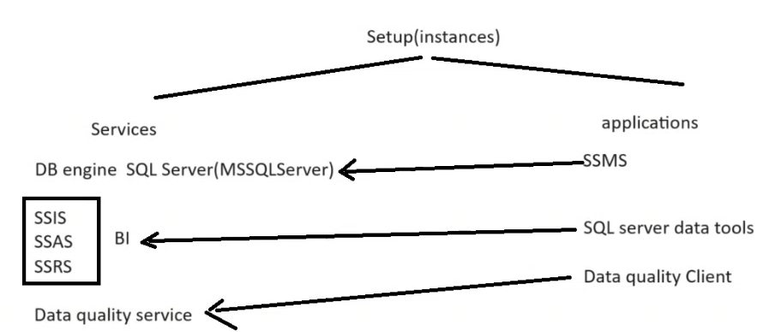
SQL
each version has group of editions like, each edition has specific features
enterprise edition , standard edition, developer edition, express edition
web edition, SQL azure edition
when setup SQL server it means you makes an instance of SQL server
instance consist of
set of services like DB engine (MSSQL server), SQL server Integration service, SQL server Analysis service
set of applications to deal with these services like SQL server management studio that deal with MSSQL Server, SQL server data tools

Slide 12
Connect to DB engine service
Once you setup the SQL server for the first time on your device default instance is created
DB engine service is downloaded, and its name is SQL Server(MSSQLSERVER)
To connect to SQL Server(MSSQLServer) you can connect by
. If the server on the same machine
local
Ip address
PC_name
If you want to setup another SQL DB engine you need to write name for instance SQL server during setup
DB engine service is downloaded, and its name is SQL Server(name_of_instance)
To connect to SQL Server(name_of_instance) you can connect by
.\name_of_instance
local\name_of_instance
name_of_instance
PC_name\name_of_instance

Slide 13
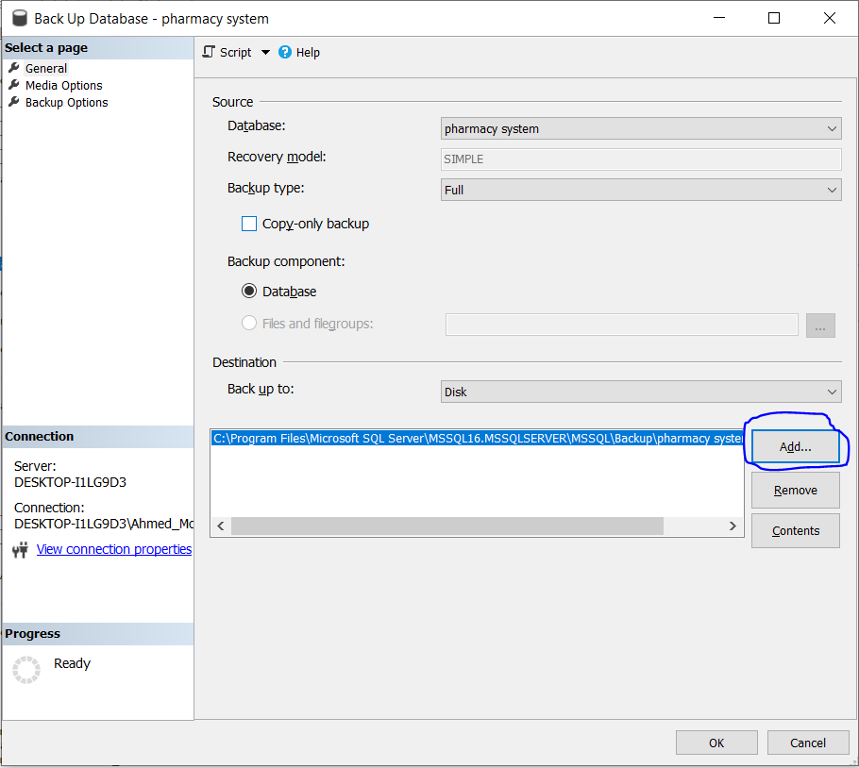
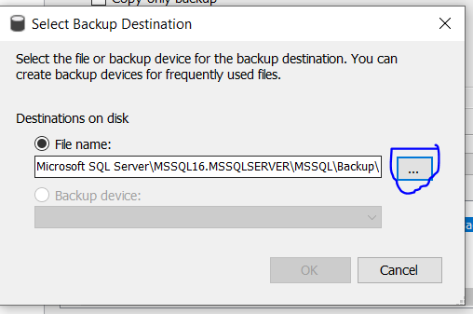
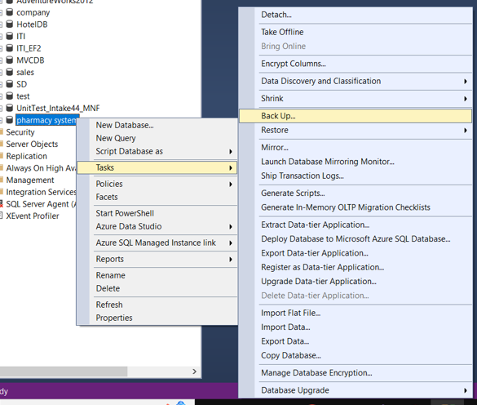
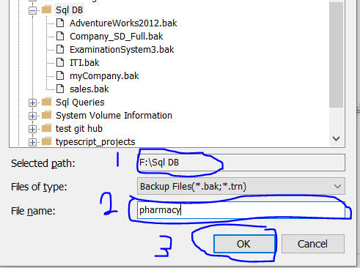
to make backup from your database
right click on database + tasks + Back up + click add to choose the path of created backup + name DB file with .bak

Slide 14
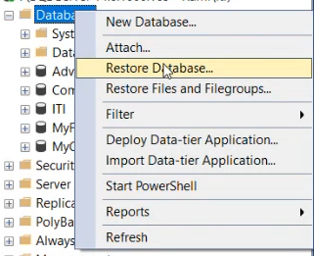
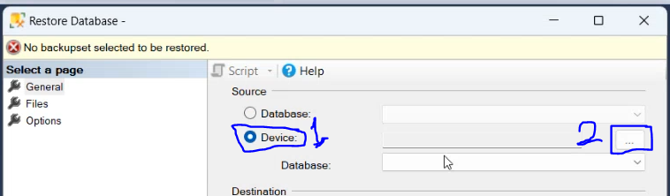
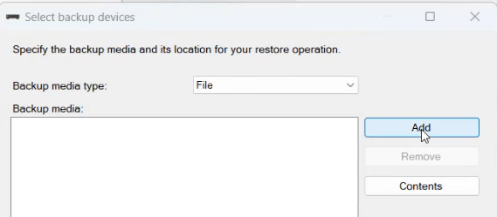
To restore DB

Slide 15
to be the owner of database to enable editing on table structure
to be the owner of database
right click on database + properties + from left select files + at owner write sa
to enable editing on table structure
Go to tools + options + designers + remove check from prevent saving changing that require table
to make backup from your database:
right click on database + tasks + Backup + click add to choose the path of created backup + name DB file with .back
to restore database:
right click on databases + device radio button + click on ... + add +

Slide 16
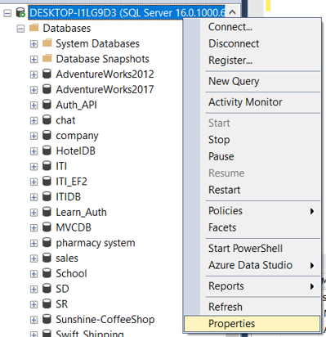
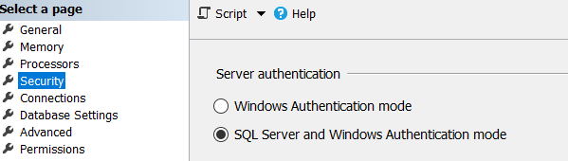
Security
Authentication: need an email and password to connect to the server
Windows authentication: windows admin == SQL Admin
SQL Server Authentication: as admin I can create logins to developers who can connect to SQL server
Restart the MSSQL service existed at background

Slide 17
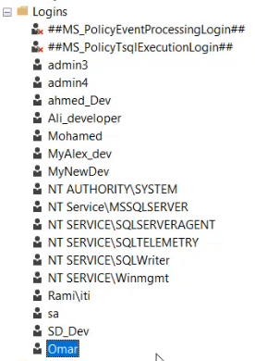
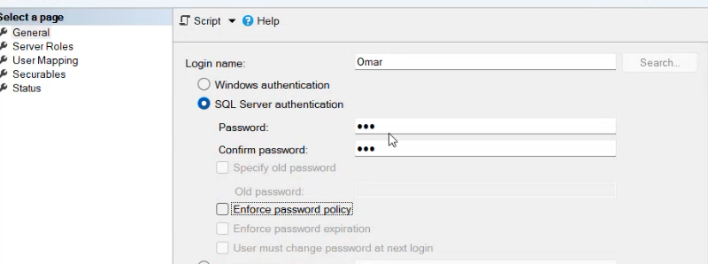
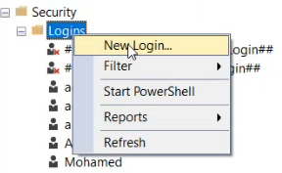
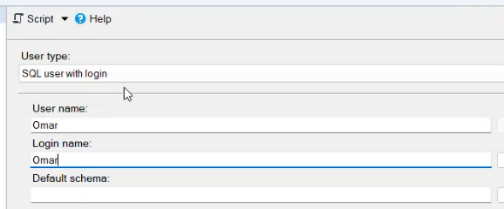
Create login [cont.]
Go to security folder on server level + login folder
Then you need to make the user able to access the DB you want so to make him able to access the DB
go to DB you want → security folder + User + right click + new user+
write the username

Slide 18
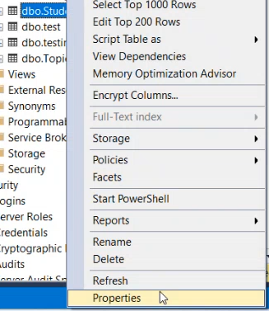
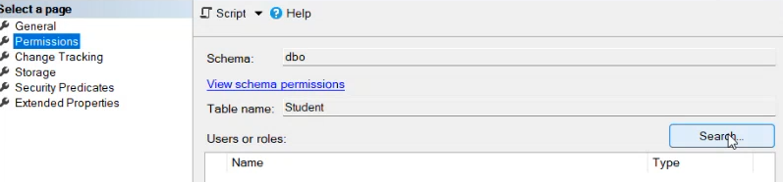
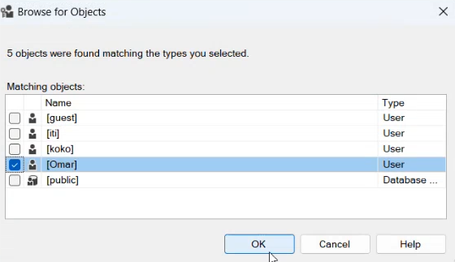
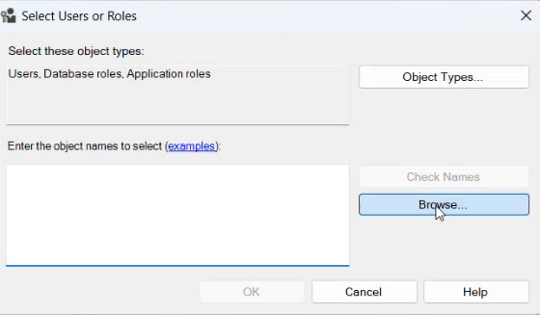
To give user permission on table

Slide 19
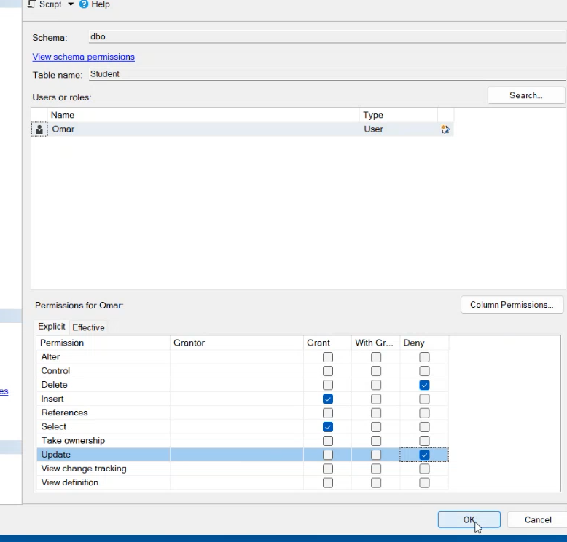
To give user permission on table [cont.]
After creating user, his server roles is public which means he does not have yet any permission

Slide 20
Admin
After creating The user of by default its server role is public
By default, we have 2 system admin at SQL Server
The first is windows user
sa used to connect to server remotely
Need to go to its property + status + enable login

Slide 21
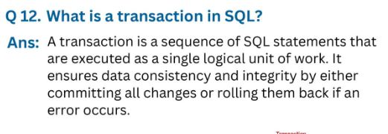
Transaction in SQL

Slide 22
Metadata & data
Metadata in a database provides information about the database itself, such as the structure, constraints, and other attributes.
The metadata of for any table
Table Name
Columns Names, data types
Constraints
Relationships
Data: the values
The created DB consist of 2 files:
.mdf(master file)[ table, relations, data , metadata]
.ldf[log file (transaction occured on database)]

Slide 23
ANSI SQL (Structured Query Language): This is the standard version of SQL which defines a set of syntax, rules and commands that are used to interact with relational databases
هو عبارة عن ال standard الخاصة بال SQL اللى متحدد فيها ال rules وال syntax وال command اللى من خلالها بنتعامل مع ال relational databases
Microsoft transaction SQL, ORACLE PLSQL are specific implementations of ANSI SQL with additional features and extensions
Categories of Microsoft transact SQL Statements
Data definition language (DDL) → CREAT, ALTER, DROP, RENAME, TRUNCATE
Data manipulation language (DML) → insert, update, delete, merge
Data retrieval command (DRC) → select, JOIN, aggregate function
Data Control Language (DCL) → make permissions for database, secure database
Data Query Language (DQL) → select statements
Transaction control Lang (TCL) → begin Transact, Commit, Rollback.

Slide 24
Data Type
numeric
bit --> boolean , 0:1
tinyint --> 1 byte
smallint --> 2 bytes
int --> 4 bytes
bigint --> 8 bytes
decimal DT
small money --> 4 bytes , .0000 // 4 digits after decimal point
money --> 8 bytes , .0000 // 8 digits after decimal point
real --> 4 bytes , .0000000 // 7 digits after decimal point
float --> 8 bytes , // 15 digits after decimal point
dec --> dec(5,2) , number with 5 digits 2 of them can be a decimal point, 12251 valid , 125.21 valid

Slide 25
Data type (cont.)
string DT
char(10) //fixed length, it reserves the entire 10 bytes even the string takes 3 bytes , support English only
varchar(30) // variable length string // it reserves based on the written , support English only
nchar(10) // support all language
nvarchar(30) // support all language
navarchar(max) // for large data up to 2GB
text // up to 8000 Bytes, exists for backward compatibility
ntext

Slide 26
Creating Database

Slide 27
Create & drop & use database
create database sd
drop database sd
use sd

Slide 28
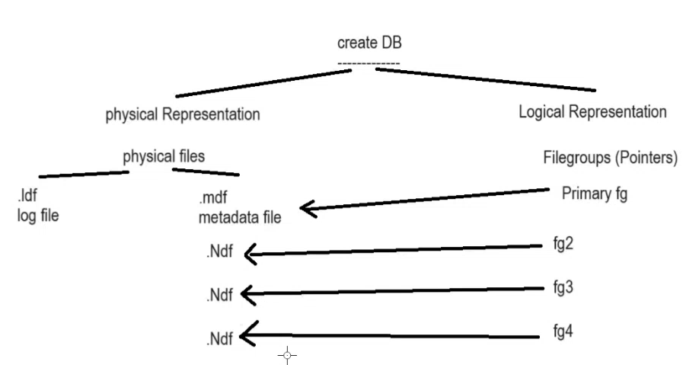
Creating DB
Database has 2 representation
1. physical representation
MDF (master data file)
LDF (Log data file)
NDF (secondary data file)
2. logical representation
Primary file group
File group1, file group2, ….

Slide 29
MDF
Stands for master data file
Every database has exactly one MDF file
It contains the actual data of database
It contains the Schema of database
Table structure
Constraints like primary keys, foreign keys, unique constraints, and check constraints
Views
Indexes
stored procedures, functions
relationship
It contains the metadata of database
descriptive information about the schema
sys object at SQL is the object that you can use to access and query on metadata
SELECT * FROM sys.tables;

Slide 30
LDF
Stands for log data file
Every database has at least one LDF
records all transactions and changes made to the database.
used during database recovery operations
During a restore operation, SQL Server uses the log file to replay transactions, ensuring that the database is brought back to the exact state it was in before a failure occurred.
Used to Rollback and Rollforward:

Slide 31
NDF
Stands for Secondary Data File
A database can have zero, one, or multiple secondary data files
They are used to store data across multiple files, what is that help for ??? Parallel Operations: SQL Server can perform parallel operations across multiple files which increase performance
If you have only MDF file without NDF files and a bad sector arises on the MDF that contains all tables, the entire database can become corrupted
You can place NDF files on different physical drives which is useful when Provided these files on the same network storage , what is that help for ??? Parallel Operations: SQL Server can perform parallel operations across multiple drivers which speed up database operations
SQL Server uses an internal mechanism to determine which file contains the data for a given query. It doesn’t care which physical drive the file is on.
Due to above reasons the NDF Improve database loading and performance especially for large databases.
each NDF file can be associated with a filegroup in SQL Server

Slide 32
File group
Primary FG: is created by default and holds (refers to) MDF file
When you creating any table on SQL server you can assign it to specific file group that refer to specific physical file
A filegroup is a logical container that holds one or more database files
Each created table by default is assigned to primary file group, you can determine the file group that table is assigned to from

Slide 33
Partitioning
partitioning a large table can significantly improve performance
Create a Partition Function
Create a Partition Scheme
Create or Alter the Table to Use the Partition Scheme
If altering: -- First, ensure the table does not already have a clustered index or other constraints
-- Add the clustered index to use the partition scheme

Slide 34
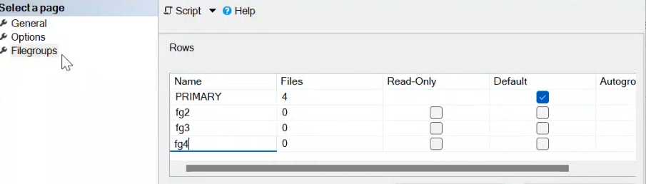
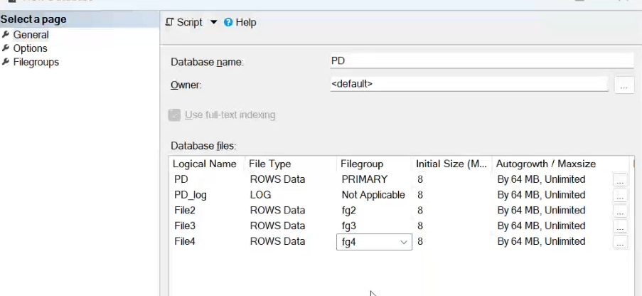

Slide 35
Schema

Slide 36
Schema
The name of any object inside DB consist of → SchemaName.ObjectName
Before schema we could not make two object with the same name
Instead of give to the SQL user permission to every single table we can group the table into schema and give the user permission on that schema
Note: Object in DB can be table, view, . . . .
Note: Group → means logical grouping
Note: the default schema is dbo, However, some objects like indexes, triggers, and constraints inherit the schema of the table
To create Schema → create schema Sales
To change the schema of object, alter schema sales transfer table1

Slide 37
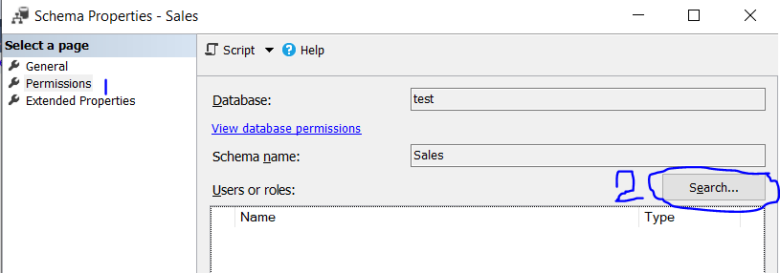
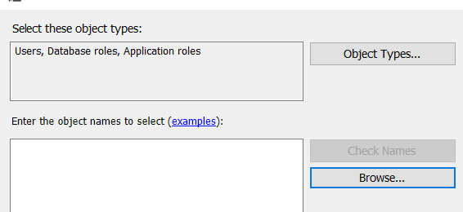
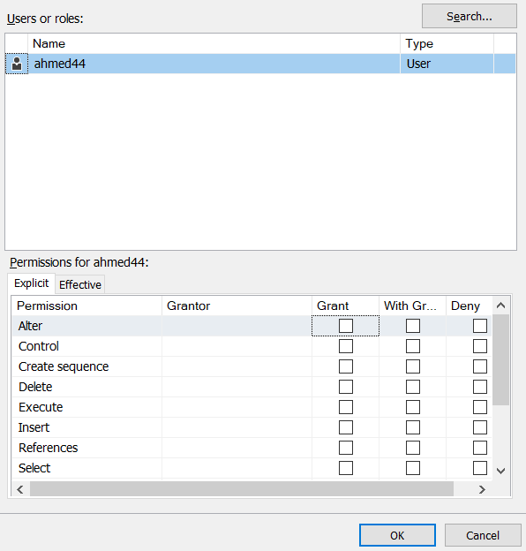
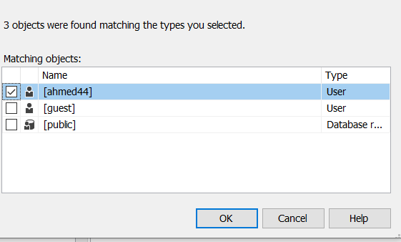
Schema [cont.]
To give user permission on schema
Double click on schema name to open schema property

Slide 38
Synonym
The full path of object is:
Databasename.schemaname.objectName
To shortcut it the full path we use the synonym instead of the full path
To create synonym
Create synonym synonym_name for object_path
To alter synonym
Alter synonym synonym_name for object_path
Select * from synonym_name

Slide 39

Column property from wizard
Default value or binding: to assign default value to column
You can assign the value you want
You can assign function call
Computed Column specification
Formula: salary + overtime → driven column
Is persisted: NO → means not stored in hard-disk, yes means stored on hard-disk
Is Sparse:
NO: if value is null it takes space on hard-disk
Yes: if value is null don’t make it has a space on hard-disk

Slide 40

Relationship property
Delete Rule: Set Null → when delete the PK, the FK become null
Update Rule: if you update the PK value the changes will be reflected to its FK
Delete Rule: cascade → commonly used with weak entity

Slide 41
DDL on table
CREATE TABLE dept (
deptno int primary key identity(1,1) clustered,
dname NVARCHAR(20) not null,
loc NVARCHAR(20) default 'cairo’,
)
ALTER TABLE dept ADD dep_location int
ALTER TABLE dept alter column dep_location NVARCHAR(30)
ALTER TABLE dept DROP COLUMN dep_location
DROP TABLE dept;

Slide 42
Constraints

Slide 43
Constrains of table
create table employee(
id int identity(1,1),
name nvarchar(15),
address nvarchar(28) default 'egypt',
hiring_date date default getdate(),
birth_date date ,
age as year(getdate()) - year(birth_date), -- computed
salary decimal,
overtime decimal,
net_salary as isnull(salary, 0)+ isnull(overtime,0) persisted, -- computed
hour_rate int not null,
gender varchar(1),
dep_id int,
constraint primary_key primary key(id, name),
constraint unique_sal unique(salary),
constraint min_salary check (salary > 1000),
constraint over_time check (overtime between 44 and 50),
constraint address_constraint check (address in ('egypt', 'cairo’)),
constraint dep_id_FK foreign key(dep_id) references department (dep_id)
on delete set null on update cascade
)

Slide 44
Constraints (cont.)
Alter table employee drop constraint c1
Alter table employee add constraint unique_sal unique(salary), //
The created constraints must match the old data
Not shared between tables
Constraints not assigned to datatype but Rule can
Column can has more than one constraints

Slide 45
Rules
It’s global [shared between tables]
Rules are only applied to the new added data unlike constraints.
the column can only have one Rule, if you assign new rule it overrides the old one
Rules can be shared between multiple columns on different tables
Example
CREATE RULE range_rule AS @value BETWEEN 1 AND 100
Binding a Rule to a Column: EXEC sp_bindrule range_rule, 'table_name.[column_name]’
To drop a rule, you can use the DROP RULE statement. However, you need to unbind it first using sp_unbindrule:
EXEC sp_unbindrule 'table_name.[column_name]'
DROP RULE rule_name
But it’s better to use CHECK constraints as it is the modern and recommended approach for enforcing data integrity constraints at the database level
Column can has constrain and rule at the same time, but constraint applied first

Slide 46
default
Create default mydef as 500
Sp_bindefault mydef, 'emp.[salary]’
To drop a rule unbind it first
Sp_Unbindefault 'emp.[salary]’
Drop default mydef

Slide 47
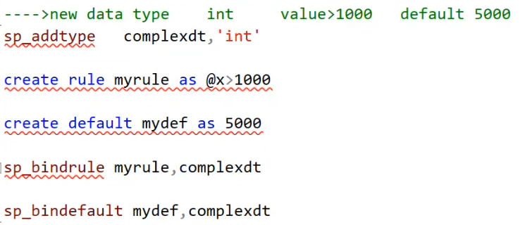
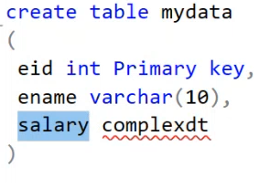
New data type

Slide 48
SQL System built in databases
Four DB for
Master:
contains all configuration of server
Metadata of server
Model:
Template that Each created DB takes an image from it
Msdb:
Responsible For jobs and alerts on SQL server
tempdb
Server stores Temporary data at run-time like the inner queries

Slide 49
execution order
subquery
from
join
on
where
group by
having
ROW_NUMBER ORDER BY
select
order by
top
union
Result

Slide 50
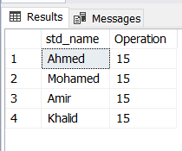
Column Alias name
select std_name, 5*3 Operation from STUDENT11
select std_name, 5*3 as Operation from STUDENT11
select std_name, 5*3 [Operation] from STUDENT11
select std_name, 5*3 "operation" from STUDENT11
select std_name, operation = 5*3 from STUDENT11

Slide 51
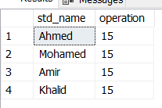
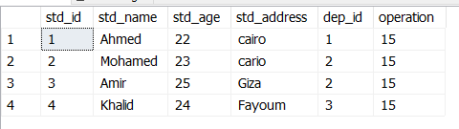
Data Query Language (SELECT)
To display extra calculated column beside the selected columns
select std_name, 5*3 operation from STUDENT11
select *, 5*3 operation from STUDENT11

Slide 52
distinct
select distinct age from Employees // unique , order ascending

Slide 53
AND & OR & [between-and] & IN & NOT & ANY & IS NULL
OR: select firstname, birthdate FROM employees WHERE city = 'Seattle' or city='Alex’
AND: select firstname, birthdate FROM employees WHERE city = 'Seattle' and age= 33
IN: SELECT * FROM products WHERE categoryId IN (1 , 4, 5);
NOT IN: SELECT * FROM products WHERE categoryId not IN (1 , 4, 5);
Between-And: SELECT last_name, salary FROM employees WHERE salary BETWEEN 2500 AND 3500;
Not Between-And: SELECT last_name, salary FROM employees WHERE salary not BETWEEN 2500 AND 3500;
ALL: select * from Student where Student.St_Age > all (select distinct St_Age from Student where Student.Dept_Id=10)
ANY: select * from Student where Student.St_Age > any (select distinct Student.St_Age from Student where Student.Dept_Id=10)
SELECT firstname FROM employees WHERE region IS NULL;
SELECT firstname FROM employees WHERE region IS NOT NULL;

Slide 54
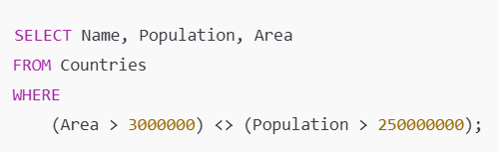
XOR
Show the countries that are big by area (more than 3 million) or big by population (more than 250 million) but not both. Show name, population and area
(Area > 3000000) → TRUE for big area
(Population > 250000000) → TRUE for big population
<> → returns TRUE if only one of them is true → XOR behavior
XOR is true only when one of the two values is true, but not both
If both are true → FALSE
If both are false → FALSE
If exactly one is true → TRUE

Slide 55
Exists Condition
EXISTS is a Boolean operator that checks for the existence of rows in a subquery. It returns TRUE if the subquery returns one or more rows, and FALSE if it returns no rows.
Retrieve the name of employees who have no dependents
SELECT E.SSN, E.FName+' '+E.LName as "full name"
FROM Employee E WHERE EXISTS (SELECT D.ESSN FROM Dependent D WHERE D.ESSN = E.SSN);

Slide 56
Like
SELECTfirst_name FROM employees WHEREfirst_name LIKE 'S%';
// % represent zero or many characters , _ represent one character.
'____' // word with 4 characters
'[ahm]%' // start with a or h or m
'[^ahm]%' // not start with a or h or m
'[a-h]%' // strat with a or b or c ....., or h
'[^a-h]%' // not start with any charachter in this range range
'[(ah)(mo)]%' // start with ah or mo
'%[%]' // string with % at end
'%[_]%' // string with _ charachter
'[_]%[_]' // string start with _ and end with _

Slide 57
Order by
SELECT last_name, job_id, department_id, hire_date FROM employees ORDER BY hire_date;
The default sort order is ascending
SELECT last_name, job_id, department_id, hire_date FROM employees ORDER BY hire_date desc;
SELECT last_name, job_id, department_id, hire_date FROM employees ORDER BY age, hire_date
order by age at first and if there is more than employee has the same age order based on hiredate

Slide 58
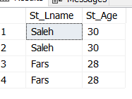
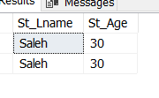
TOP, Top with ties
Top 2: take the first two rows
Not work with group by
Top 2 with ties:
Need order by
it includes any additional rows that have the same value in the ORDER BY last row in the top 2
select top 2 with ties students.St_Lname, students.St_Age from students order by St_Age desc
select top 3 with ties students.St_Lname, students.St_Age from students order by St_Age desc
select top 2 with ties students.St_Lname, students.St_Age from students order by St_Age desc

Slide 59
Joins
The mechanism : For each row in the left table compare it with all rows in the right table even if matching and return the pairs that match the condition.
To make query from more than one table
Types of Joins
Cross join
Cartesian product
Inner join
Outer join
Left outer join
Right outer join
Full outer join
Self join
With Unary Relationship

Slide 60
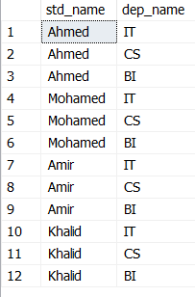
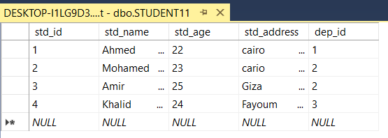
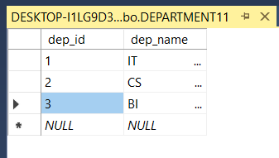
cross join (Cartesian product)
select std_name, dep_name from STUDENT11, DEPARTMENT11
select * from DEPARTMENT11 cross join STUDENT11
Cartesian product does not have any meaning in business

Slide 61
Inner join
used to combine fields (columns) from two or more tables
it displays only the rows that have a match in both the joined tables
the formula of join → parent.PK = child.FK
called equi join
from student , dept where student.id = dept.stdId ➔
from student inner join dept on student.id = dept.stdId

Slide 62
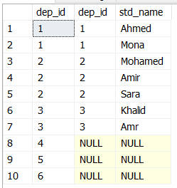
Left outer join example
select D.dep_id, S.dep_id, S.std_name
from Department11 D
left outer join STUDENT11 S
on D.dep_id = S.dep_id
Note that dep_id at D, S
Left outer join: it displays all the rows from first tbl and matched rows from second tbl
Right outer join:it displays all the rows from second tbl and matched rows from first tbl
Full outer join : it displays all the rows from both tables whether it matched or not.

Slide 63
Multi join
Multi join
FROM Orders INNER JOIN Customers
ON Orders.CustomerID = Customers.CustomerID
INNER JOIN Products
ON Orders.ProductID = Products.ProductID
WHERE Orders.OrderDate >= '20240101' ORDER BY Orders.OrderDate DESC;

Slide 64
Multi join
Multi join
FROM Orders INNER JOIN Customers
ON Orders.CustomerID = Customers.CustomerID
INNER JOIN Products
ON Orders.ProductID = Products.ProductID
WHERE Orders.OrderDate >= '20240101' ORDER BY Orders.OrderDate DESC;

Slide 65
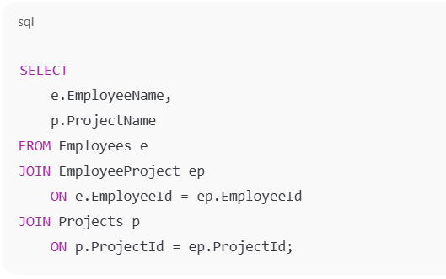
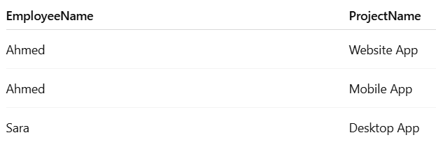
Multi join Example
The relationship between employee and project is many to many
Write SQL statement that display the employee's name and project name

Slide 66
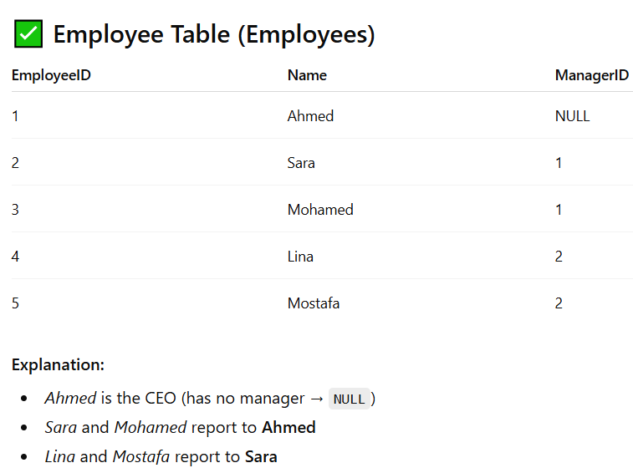
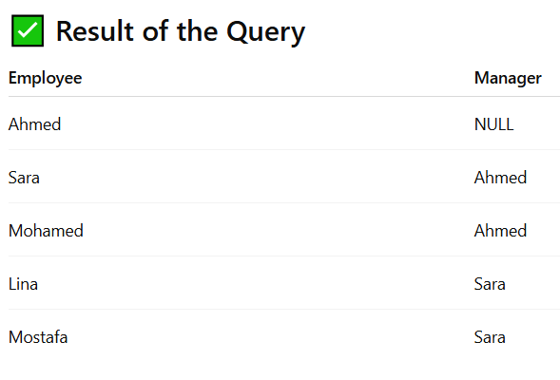
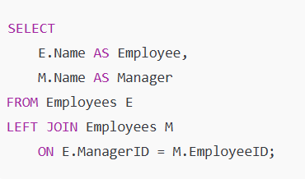
Self join
often used with self relationship
example for each employee display data of his manager

Slide 67
Select into
Create table from existed one
select * into tab2 from instructor
this query creates a new table called tab2 and copy all the data of table instructor into the new created table.
we can’t run this query twice because we can’t have two table with the same name.
select * into tab7 from student where 1=2
false condition this query will create a new empty table (tab7) which have the same structure as Student table Because this condition won’t ever happen.
Note select into: make copy of DT, Values, name of columns, does not copy constraints

Slide 68
Combining the result sets of two queries
In SQL, you can use the "UNION" and "UNION ALL" operators to combine the results of two or more SELECT statements into a single result set.
select std_name from employee union all select ins_name from instructor
UNION operator is used to combine the results of two SELECT statements and remove any duplicate rows (get the distinct (unique, order by))
UNION ALL operator is used to combine the results of two SELECT statements and include all the rows, even if they are duplicates.
Intersect get the common , distinct (unique, order by)
EXCEPT: returns any distinct values from the left query that are not also found on the right query
The basic rules for combining the result sets of two queries
The number and the order of the columns must be the same in all queries
The data types must be compatible

Slide 69
Data manipulation language (insert)
Insert
note department structure is [dep_id, dep_name]
insert into DEPARTMENT (dep_id, dep_name) values(8, 'SC’);
insert into DEPARTMENT(dep_id, dep_name) values(7, '.NET'), (9, 'SE');
insert into DEPARTMENT(dep_id ) values(17)
insert into DEPARTMENT values(18, 'SW’)
insert into DEPARTMENT values(20, 'MERN'), (21, 'MEAN’)
insert INTO student (std_id, std_name, dep_id) insert based on select
SELECT 22 , ‘Khalid', dep_id
FROM department
WHERE dep_name = 'PD’;

Slide 70
Bulk insert
the `BULK INSERT` statement is used to efficiently insert large amounts of data from an external data file into a table
It is commonly used when you have a file containing structured data that you want to import into a SQL table
BULK INSERT target_table
FROM 'C:\data\employees.csv’
WITH ( FIELDTERMINATOR = ',’)
BULK INSERT Employees
FROM 'C:\data\employees.csv' WITH (
FIELDTERMINATOR = ',’,
ROWTERMINATOR = '\n’,
FIRSTROW = 2, BATCHSIZE = 1000,
ERRORFILE = 'C:\data\bulk_insert_errors.txt' );

Slide 71
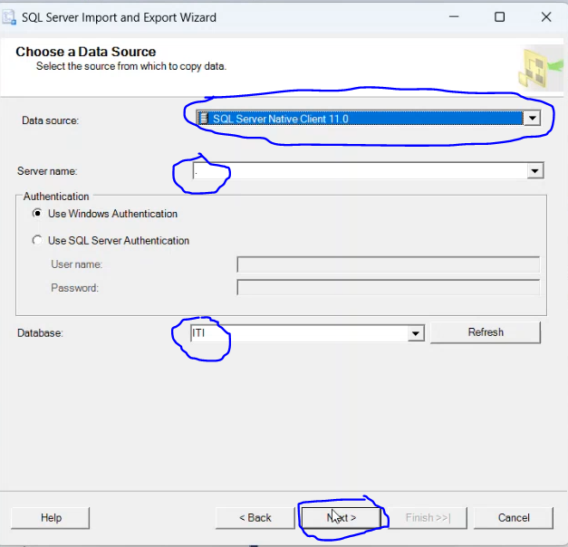
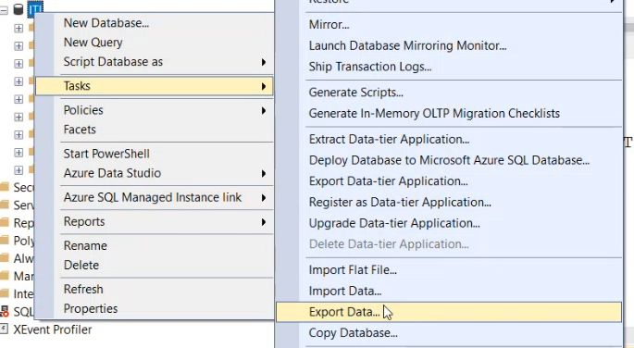
Export Data
Click next

Slide 72
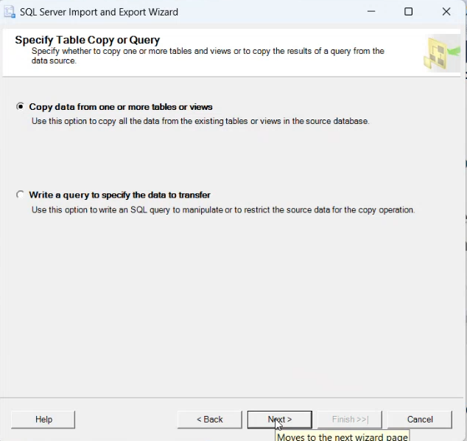
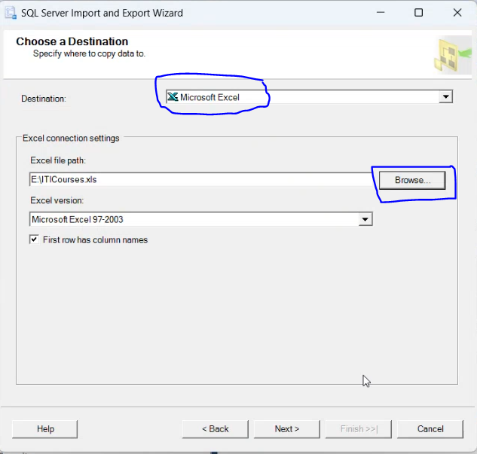
Export Data (cont.)

Slide 73
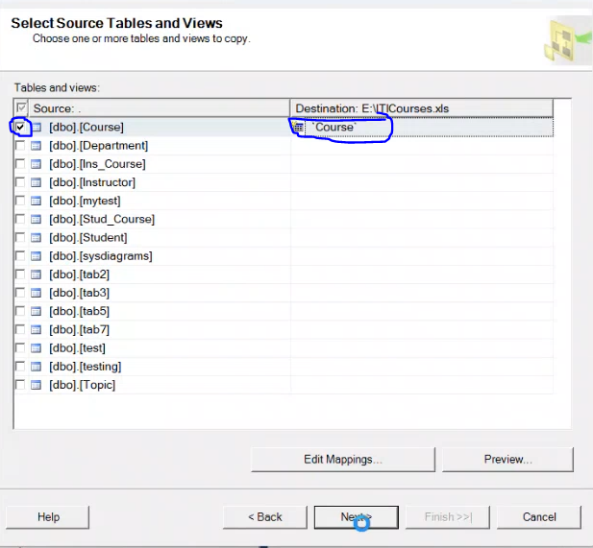
Export Data (cont.)

Slide 74
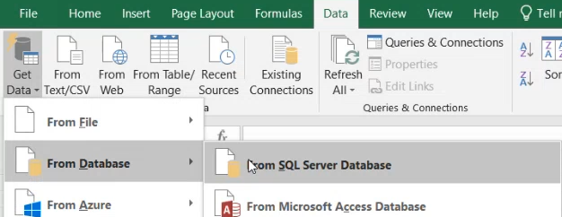

Import data using excel

Slide 75

Import data using excel(cont.)

Slide 76
Identity Insertion
Each table has only one identity column
Identity(1,1)
To enable `IDENTITY_INSERT`: SET IDENTITY_INSERT Table_name ON
To disable `IDENTITY_INSERT`: SET IDENTITY_INSERT Table_name OFF
Select SCOPE_IDENTITY() -- get the last inserted identity value
dbcc checkident(tbl_name, reseed, 6) – reset identity to value 6

Slide 77
Data manipulation language (Update)
update employees set department_id = 70 where employee_id = 15;
UPDATE std_crs SET grade = grade + 10
FROM std_crs sc INNER JOIN student s
ON s.std_id = sc.std_id
WHERE s.address = 'alex';

Slide 78
Data manipulation language (delete)
DELETE FROM departments WHERE department_name = 'Finance’;
Delete DEPARTMENT11
from DEPARTMENT11 D left join Student11 S
on D.dep_id = S.dep_id
where S.dep_id is null
Delete from DEPARTMENT11 == delete DEPARTMENT11

Slide 79
Start Aggregate function

Slide 80
Aggregate function
Grouping functions : count , max , min , avg , sum
Group functions operate on set of values to return ONE value.
Select MAX(UnitPrice) From Products Where CategoryId = 20;
Aggregate functions neglects the row with null value which means if I want to calc the avg to #rows = 4 and there is one row with null value so the avg will be calculated (sum of not null values)/3

Slide 81
End Aggregation function

Slide 82
Grouping & Having
Select MAX(UnitPrice) From Products Where CategoryId = 20;
What if we need to display max unit price for products of each category ? We need to repeat the select statement x times where x is the number of categories in the system. therefor the group by function exist
Select MAX (UnitPrice) From Products group by CategoryId;
Having: filter the group
select title count(*) from employee group by title having count(*)>4
select min(salary) , dep_id from employee // error as we can't select aggregate function with normal columns without group by
select min(salary), dep_id from employee group by dep_id

Slide 83
Grouping & Having
You cannot use aggregation methods with WHERE
WHERE tbl.earnings = MAX(tbl.earnings) -- this is not allowed
The WHERE clause is evaluated before aggregate functions like MAX().

Slide 84
Grouping examples
for each department find the sum of salaries of employees
Select sum(salary)[sum of salary] group by dep_id
write the query that dispaly the dep_id , dep_name, count of student at each department that has more than 5 students
select D.Dept_Id, D.Dept_Name, COUNT(D.Dept_Id) from Department D, Student S
where D.Dept_Id = S.Dept_Id
group by D.Dept_Id, D.Dept_Name
having COUNT(D.Dept_Id) > 5
Select Sum(Salary) From Instructor Having count(Ins_Id)<100
this query calculates the sum of salaries of instructors if the number of the instructors is less than 100

Slide 85


Subquery
You can not reference an alias table in another subquery
for example,

Slide 86
Data Control Language (DCL)
Data Control Language (DCL): is a subset of SQL that deals with the permissions and access control of the database
Grant Used to give users access privileges to the database
REVOKE: Used to remove access privileges from users.
GRANT SELECT ON Employees TO user1;
GRANT SELECT ON Employees TO Ahmed WITH GRANT OPTION;
the user ahmed can now pass on the SELECT privilege to other users.
Grant All on Table department to Mary, Ahmed;
Revoke update on Table department From Mary;
Revoke All on Table department From Mary, Ahmed;

Slide 87
Normalization
The process to avoid duplication [data redundancy]
avoid insert, update, delete anomalies[strange behavior] that is occurred due to table has more than one entity
avoid unnecessary dependency between entities
breaking down table into two or more tables
functional dependency
relationship between columns in the same table where the value of one column (the "dependent" column) is determined by the value of another column
A→ B , for each unique A there is new B or B depend on A
example Std_id → std_name, std_address
example Std_id,crs_id → grade // composite key
so we ensure that table is correct when all columns depends on PK

Slide 88
Normalization continue
type of functional dependency
full functional dependency : you can find(determine) the value of column based on the primary key
partial functional dependency : you can find the value of column based on the part of primary key (composite key)
transitive functional dependency : you can find the value of column based on another column not primary
Normalization steps
first: ask for what is enitity that table represnt
remove multivalued attribute or repeating groups → first normal form
remove partial dependency → second normal form
remove transitive dependency → third normal form

Slide 89

example

Slide 90
index
Index: used to increase the performance of database
Index: allow the database engine to find and retrieve specific rows much faster than scanning the entire table
Type of index
Clustered index
Non-clustered index
We have only one clustered index per table, table can have multiple non-clustered indexes.
Clustered index
When we create a table without primary key, table data will be stored as heap (not sorted) . So, when we run a select query, table scan will be done(bad performance).
Heap: A heap is a table without a clustered index. The data rows are not stored in any order; they are simply stored as they come in, in no specific sequence.
When we set a primary key constraints to the table, then a clustered index will be generated automatically which means data is sorted and stored on hard disk based on PK.
Index is implemented as binary+ tree (binary plus tree), containing 3 levels

Slide 91
Binary plus tree
Binary plus tree of clustered index Consist of
Root Node: contains the median value of the entire dataset, splitting the data into two balanced halves, contains pointers to intermediate nodes.
Internal Nodes: Nodes between the root and leaf nodes that help navigate to the correct leaf node.
Leaf Nodes: The actual data pages of the table, containing the complete rows of data, ordered by the index key.
Non clustered index
Binary plus tree of non-clustered index like clustered but the last level(leaf node) is a pointer to actual data
It is also stored on disk.
creating non-clustered index → create non-clustered index I2 on student(st_fname)
Recommended to be applied on columns that used continuously for filtering

Slide 92
Notes on index
If a table doesn’t have a primary key, then the clustered index can be created on any column
When we create a Unique constraint on a column, it automatically generate non-clustered index
Indexes enhance database performance with searching (select query) but not the best choice with DML queries
If a table doesn’t have a primary key, then the clustered index can be created on any column. After that if we set other column as primary key it will have non clustered index. Because there can be only one clustered index per table but there can be several non-clustered indexes in a table.

Slide 93
What's the difference between a primary key and a unique key
primary key:
There can only be one primary key in a table
can't be null
unique
unique key :
can be more than one unique key in one table
can have NULL values

Slide 94
database replication
creating copies of database to distribute loading across multiple servers These copies are kept in sync with the primary database, ensuring that all copies reflect the most current data
primary database: The primary database is the main database where all write operations (inserts, updates, deletes) occur can introduce latency
Replica database: copies of the primary database. They typically receive and apply changes made to the primary database to stay in sync, used for read operations (select queries), thereby offloading some of the load from the primary database.
Replication Lag: This refers to the time delay between when a change is made on the primary database and when that change is reflected on the replicas. Minimizing replication lag is important for ensuring that replicas provide up-to-date data
Synchronous Replication: Changes made on the primary database are immediately applied to the replicas before the transaction is considered complete. This ensures data consistency but can introduce latency
Asynchronous Replication: Changes are sent to replicas after the transaction on the primary database is complete. This is faster and reduces latency but may result in temporary inconsistencies between the primary and replica databases.

Slide 95



OFFSET, FETCH NEXT number_of_rows ROWS only
select * from Employee order by Salary desc
SELECT SSN, Fname, Salary FROM Employee ORDER BY Salary DESC
OFFSET 2 ROWS
SELECT SSN, Fname, Salary FROM Employee ORDER BY Salary DESC
OFFSET 1 ROWS FETCH NEXT 2 ROWS only

Slide 96
Ranking Functions

Slide 97


Ranking function
The reasons we need ranking function:
Grouping method only get the calculation
We can’t get for each department the data of employee who has the second highest salary,
ROW_NUMBER() Assigns a unique number to each row in the result set, without any gaps. The numbering starts from 1 and increments by 1 for each subsequent row
select *, ROW_NUMBER() over (order by salary desc) [RN] from Student11

Slide 98


Ranking function
DENSE_RANK()
Assigns a unique rank to each row, with equal values receiving the same rank like Rank() but there are no gaps in the rank values, even if there are ties. The next rank is not skipped
select *, Dense_Rank() over (order by salary desc) [DR] from Student11

Slide 99

DENSE_RANK() [cont.]
select * , dense_rank() over (order by salary) as DR from Employee where DR = 2
This is an error due to the execution order → from employee then where DR there is no column DR in employee
select * from (
select * , dense_rank() over (order by salary) as DR from Employee) as tbl
where tbl.DR = 2
This SQL query is designed to find employees who have the second-highest salary, including any ties
select tbl.Fname, tbl.Salary from ( select * , dense_rank() over (order by salary) as DR from Employee) as tbl where tbl.DR = 5

Slide 100

Ranking function
Rank(): Assigns a unique rank to each row, with equal values receiving the same rank. The next rank is skipped if there are ties
select *,Rank() over (order by salary desc) [RN] from Student11

Slide 101


Ranking function
Ntiles(Num_of_groups)
Divides the result set into a specified number of equalized
groups or buckets and assigns a group number to each row.
select *, Ntile(2) over (order by salary desc) [NT]
from Student11
select *, Ntile(3) over (order by salary desc) [NT]
from Student11

Slide 102

Ranking function with partition by
Select * From ( Select *, Row_number() over(Partition by dept_id order by salary desc) as RN from employee) as newtable where RN=1
Divide table into group based on dept_id
Order each group based on salary
Apply Row_number() on each group
This means Select the most employee with the most salary on each group
Group by : بتخفى ال rows وتطلع الناتج بتاع العملية الحسابية
Partition by : دى بتقسم ل groups من غير ما تخفى ال rows

Slide 103
Start BUILT In Method

Slide 104
methods that work with null, isnull, coalesce, NULLIF
select isnull(Fname, 'no name') // replace any null value at column Fname with 'no name’
select coalesce(Fname, Lname, add , 'no data') // if Fname is null replace with Lname if null replace with add if null replace with 'no data’
SELECT NULLIF(price, 0) FROM products;
This query will return the price of each product, but if the price is 0, it will be replaced with null.

Slide 105
Built in method [Round]
Select(number, NoOfDigitsAfterDecimalPoint)
select ROUND(3.516, 0); -- Result: 4
select ROUND(3.499, 0); -- Result: 3
select ROUND(123.456, 2); -- Result: 123.46
select ROUND(123.454, 2); -- Result: 123.45
select ROUND(123.456, 2, 1); -- Result: 123.45 (truncates instead of rounds)
select ROUND(748.58, -2 ); -- Precision = -2 → round to hundreds so , 748.58 → 700
Precision: -1 → round to nearest tens
Precision: -2 → round to nearest hundreds

Slide 106
CAST
The syntax
CAST(expression AS datatype)
SELECT CAST ( GETDATE() DATE );

Slide 107
Built in method on date
select getdate(); // get date and time now
select year(getdate())
select month(getdate()) //
select day(getdate())
select DATEDIFF(year , data1 , date2) // get the difference of two date in year
select DATEDIFF(month , data1 , date2) // get the difference of two date in month
select DATENAME(MM,getdate()) -- August
select DATENAME(MONTH,getdate()) -- August
select DATENAME(YYYY,getdate()) -- 2024
DATEADD ( MONTH, 10, CAST(GETDATE() AS DATE) ) AS LastDate
Add to the current date 10 months
select FORMAT(GETDATE(), 'dd-MM-yyyy hh:mm:ss tt') -- 06-08-2024 16:59:08 PM
select FORMAT(GETDATE(), 'ddd-MMM-yy HH:mm:ss tt') -- Tue-Aug-24 16:59:59 PM
select FORMAT(GETDATE(), 'dddd-MMMM-yyyy HH:mm:ss tt') -- Tuesday-August-2024 17:01:39 PM

Slide 108
Built in method
select convert(varchar(30), age) // convert the integer age to string
select concat(Fname , ' ', age) // convert to string and concatenate, if there is null value replace it with ''
select concat_ws ('||', 'ahmed', 'ali', 'mohamed') // ahmed||ali||Mohamed
Space(5) // return 5 spaces
select QUOTENAME('ahmed', '[') // [ahmed] , select QUOTENAME('ahmed', '"') // "ahmed"
Trim(fname)
REVERSE('ahmed') // demha
len('ahmed') // 5 , order by len(first_name) desc → order based on length of string
select UPPER('ahmed') -- AHMED
select lower('AHMED') – ahmed
select SUBSTRING('ahmed', 1, 3) -- ahm , note that first index here at 1
Sqrt(16) // 4

Slide 109
Built in method (Round down, round up)
Floor()
Ceil()

Slide 110
newid()
It generates a new unique identifier (GUID) value on server level
A GUID (Globally Unique Identifier) is a 128-bits identifier that is globally unique
Can be used when I want to select the rows randomly [not descending or ascending]
select * from student order by newid()
select * , newid() as X from student order by X
select top(1) * from student order by newid() //this query is used to get a random student each time you run it
At creating table
User_id uniqueidentifier primary key default newid()

Slide 111
SCOPE_IDENTITY()
It get last identity value generated
declare @questionId int = SCOPE_IDENTITY()

Slide 112
Declaring variable
DECLARE @MovieCount INT;
SET @MovieCount = 50;

Slide 113
IIF()
IIF(condition, returned_value_if_true, returned_value_if_false)
SELECT EmployeeName, Salary, IIF(Salary > 5000, 'High', 'Low') AS SalaryCategory

Slide 114

If condition

Slide 115
Function (user defined function) (Scalar function)
return one value
create function getsname(@id int)
returns varchar(30) //function signature
begin
declare @name varchar(30)
select @name=st_fname
from Student
where st_id=@id
return @name
end //function body
select dbo.getsname(1) //scalar functions must be called with schema name

Slide 116
Function (user defined function) (inline table function)
return Table
contain select statement only
create function getins(@did int)
returns table
as
return
(
select ins_name,salary*12 as total
from Instructor
where dept_id=@did
)
select ins_name from getins(10) where total>9000

Slide 117
Function (user defined function) (multi-statement table-valued function)
allows you to perform multiple operations within a function and return a table as a result
Example
create function getstuds(@format varchar(10))
returns @t table
(
id int,
name varchar(30)
)
AS
BEGIN
if @format='first’
insert into @t select st_id,st_fname from Student
else if @format='last’
insert into @t select st_id,st_lname from Student
else if @format='full’
Insert into @t select st_id,st_fname+' '+st_lname from Student
return
END

Slide 118
Stored procedure
Types of stored procedure:
Built-in SP
User defined SP
Triggers
Stored proc pros
Precompilation: Stored procedures are compiled once and stored in a compiled state. When they are executed, the database engine does not need to parse and compile the SQL statements again, which improves execution speed.
QL Injection Prevention: By encapsulating SQL statements within stored procedures, you reduce the risk of SQL injection attacks since parameterized queries can be used
Normal query lifecycle
Query ➔ Parsing (making sure query syntax is correct) ➔ Optimizing (making sure query metadata is provided correctly) ➔ Query Tree (From Where Select) ➔ Execution Plan (execute query in memory). When we call a stored procedure for the first time, it goes through the entire query lifecycle but when we call it againg it gets executed directly because query tree is saved in memory which enhances performance.

Slide 119


Stored procedure

Slide 120

Trigger
special Stored Procedure
implicit code
can’t be called
can't take paramters
run according actions
In SQL, a trigger is a set of SQL statements that are automatically executed in response to certain events or actions performed on a table, such as an `INSERT`, `UPDATE`, or `DELETE` operation.
triggers can be enabled or disabled or dropped
alter table department disable trigger tr_4
alter table department enable trigger tr_4
create trigger tr_3
on student11
instead of delete
as
select 'not allowed to delete'
create trigger tr_1
on student
after insert
as
select 'welcome to ITI'

Slide 121
Triggers (cont.)
Triggers can be used for a variety of purposes
Auditing: Triggers can be used to track changes to the data in a table by recording information such as the user who made the change and the time of the change
Replication: Triggers can be used to replicate data to other databases or tables.

Slide 122
The difference SP delete and function
Feature | Function | Stored procedure
param | Function takes at least one parameter , it's a mandatory | it's an optional to take parameters.
Param type | Functions can have only input parameters | can have input parameter , output parameters //input defualt parameter
return | Function must return a value | it's an optional to return a value
calling | Can be used directly within SQL queries. | Cannot be directly used within SELECT, WHERE, HAVING, or other clauses of SQL queries. They are executed as a separate statement.

Slide 123
view
view is a virtual table based on the result-set of an SQL statement.
Used to encapsulating complex queries that includes for example joins
It provides a layer of security by limit access to certain data or present data in a controlled manner For example, you might create a view that only includes a subset of columns or rows, thereby hiding sensitive data from users who don’t need to see it.
We can’t write DML queries in views body, but we can run DML queries on View as if it was a table and changed could be reconciled to original data but in some conditions
It does not store data physically. It’s a stored query that gets executed each time you access the view
executed each time you access the view
create view v2(studept_name,dept_name)
WITH ENCRYPTION
as
select st_fname,dept_name
from student s,department d
where s.dept_id=d.dept_id
and s.st_address='cairo'
create view v2(studept_name,dept_name)
as
select st_fname,dept_name
from student s,department d
where s.dept_id=d.dept_id
and s.st_address='cairo'
//if we run sp_helptext v2 we can get the code of the view, so it’s better to encrypt view

Slide 124
View (cont.)
When you perform an INSERT, UPDATE, or DELETE operation on a view in SQL Server, the changes are typically reconciled or reflected in the underlying tables provided some conditions
Running DML query on View that created from one table
We can run delete statement
We can run insert or update statement on columns that are included in the view, but you must make sure that other columns that aren’t included in the view have (allow Null, default value, identity, ) .
Create view v13
as
select st_id,st_fname,st_age from student
where st_age=20
with check option //this means we can only insert ages that match the condition(st_age=20)
insert into v13 values(111,'ali',33)
//this query won’t run because we’re only allowed to insert student with age 20

Slide 125
View (cont.)
Running DML query on View that created from multiple table
We can’t run delete statement (because we can’t delete two rows from different tables at the same time).
We can run insert or update statement only if data is inserted or updated into one table.

Slide 126
materialized view
improve database performance specially for complex queries on large dataset and storing the result of a query physically in the database
store the results of complex queries (like joins, aggregations, and computations) as a physical table. This eliminates the need to recompute these results every time the query is executed.
the database retrieves the precomputed results directly from the stored view
Improved Performance for Repeated Queries
Use Cases
Reporting: Reduce the time needed to generate reports
Data Warehousing: where complex analytical queries are run on large datasets.
Create materialized view
CREATE MATERIALIZED VIEW sales_summary AS
SELECT region, SUM(amount) AS total_sales FROM sales GROUP BY region;
You can query the materialized view just like a regular table:
SELECT * FROM sales_summary;

Slide 127
materialized view (cont.)
If new data is inserted into the sales table and you want the materialized view to reflect the latest data, you need to refresh it
REFRESH MATERIALIZED VIEW sales_summary;
Refreshing the Materialized View

Slide 128
The difference between delete and truncate
Feature | DELETE | TRUNCATE
command | DML (Data Manipulation Language) | DDL (Data Definition Language)
 | It removes rows from a table based on a specified condition using the WHERE clause. If no WHERE clause is provided, all rows in the table are deleted. | It removes all rows from a table
Logging | it records all the deleted data rows in the transaction log | Record Data Pages only ( basic units of storage in SQL Server, Each data page has a fixed size of 8 KB and can hold multiple rows of data)
Triggers | Triggers on the table will be fired for each deleted row | Triggers do not fire because TRUNCATE does not operate on individual rows
Rollback | can be rolled back
Identity Columns | does not reset identity columns | reset identity columns

Slide 129
what a search argument is
• Conditional statements include operators such as: =, >=, <>, <=, >=.
Predicates are statements that return a TRUE, FALSE such as → like, CONTAINS, EXISTS, IN, IS [NOT] NULL,

Slide 130
Cursor
A cursor in SQL Server is a database object that allows you to process rows one-by-one, like a loop.
We use a cursor only when we cannot solve the problem using normal set-based SQL.
Performing complex calculations that depend on the result of the previous row
Calling stored procedures for each row
Applying logic that cannot be expressed in pure SQL
When NOT to use cursors
When the task can be solved using a single UPDATE/INSERT/DELETE
When performance is important (cursors are slow)
When the table is large (cursors process one row at a time = slow)
Example Scenario
An insurance company wants to send emails to customers whose policies expire soon. You need to loop through each customer and execute a stored procedure that sends the email. You cannot do this with a simple SELECT or UPDATE because it involves external procedural logic.

Slide 131

Cursor Example
DECLARE cursor – defines which rows will be processed.
OPEN cursor – loads the rows from the query.
FETCH NEXT – moves the cursor and retrieves the next row.
WHILE loop – continues until no rows left.
Business logic – execute stored procedure, update several tables, send email, etc.
CLOSE / DEALLOCATE – frees resources.

Slide 132
Global Variables
select @@SERVERNAME //display your server name
select @@version //display your version of sql server.
select @@rowcount //display number of raws affected by the last query
Select @@error //display number of error message caused by last query
Select @@identity // returns the last identity value generated for any table in the current session and

Slide 133
Backup types
full backup: includes the entire database
differential backup includes only the data that has changed since the last full backup
transaction log backup backs up the transaction log, which contains a record of all transactions that have occurred since the last transaction log backup
File and Filegroup Backups: allow you to back up individual files or filegroups within a database. This can be useful for very large databases that are divided into multiple files or filegroups
Copy-Only Backup: for specific purposes, such as testing or development, without interrupting the regular backup strategy.
Backup Strategy For effective database backup and recovery, it’s crucial to design a comprehensive backup strategy that combines these different types of backups based on your needs:
Full backups are typically taken weekly or monthly.
Differential backups are taken daily or multiple times per week.
Transaction log backups are taken frequently (e.g., every 15 minutes or hourly) to minimize data loss.

Slide 134
Start Question

Slide 135
Very important question
Department (1) student (N)
Delete department that has not student
Delete from department where dep_id not in (select distinct dep_id from student)
Another solution
delete DEPARTMENT11
from DEPARTMENT11 D
left join Student11 S on D.dep_id = S.dep_id
where S.dep_id is null
Delete department == delete from department
Another solution
DELETE D FROM Department D LEFT JOIN Student S
ON D.Dept_Id = S.Dept_Id
GROUP BY D.Dept_Id HAVING COUNT(S.Student_Id) = 0;

Slide 136



requests that have exactly 3 guarantors,

Slide 137


requests that do not have a matching guarantor.

Slide 138
End Question

Slide 139
Start Select

Slide 140


Subquery select
Subquery inside the select statement also called scalar subquery
Select inside select must return one column

Slide 141

Select with insert

Slide 142

Select insert join

Slide 143
Give value to variable via select
DECLARE @CustomerId DECIMAL(18,0);
SELECT @CustomerId = Customer_ID
FROM SMEs_prod.TWF.Flow_Customers
WHERE QID = @QId;

Slide 144
End select

Slide 145
CASE

Slide 146


CASE 1
CASE WHEN condition THEN result WHEN condition THEN result ELSE default_result END
Order by HR then IT

Slide 147
CASE with count & sum
Count without condition
SELECT COUNT(*) AS sd FROM TWF.Flow_Funding_request;
Count(*) == count(1) == count(0)
Count with condition
SELECT COUNT ( CASE WHEN status_code = 9 THEN 1 END ) [ num ] FROM Flow_Funding_request;
As long as the value is not null it will be included in count (aggregate function)
Sum with condition
SUM ( CASE WHEN status_code = 9 THEN 1 ELSE 0 END) AS Approved,

Slide 148
END CASE

Slide 149
Start Common Table Expression (CTE).

Slide 150


Common Table Expression (CTE)
A CTE is a temporary named result set that exists only for the duration of a single SQL statement (SELECT, INSERT, UPDATE, DELETE, or MERGE).

Slide 151



Common Table Expression (CTE)
Why we use it : Example 1 – Improve readability

Slide 152
End Common Table Expression (CTE).

Slide 153
Start Outer and cross Apply

Slide 154
What is OUTER APPLY Mechanism?
Left table is executed
OUTER APPLY executes the right-side query once for every row from the left-side table.
If the right-side query returns rows, they are joined.
If it returns nothing, SQL Server still returns the left row, with NULL values for the right-side columns.
It behaves similarly to a LEFT JOIN, but the right side can reference columns from the left row.
There are two types:
CROSS APPLY → Like INNER JOIN
OUTER APPLY → Like LEFT JOIN

Slide 155

example

Slide 156

Cross apply

Slide 157
End Outer and cross Apply

Slide 158
Start Correlated vs. non-correlated subqueries

Slide 159

Correlated vs. non-correlated subqueries
Non-correlated subquery:
subquery can be executed first because it doesn't depend on the outer query.
Correlated subquery
depend on the outer query.
This query is to get all customer that has orders

Slide 161
End Correlated vs. non-correlated subqueries

Slide 162
Start Exist

Slide 163

Start Exists Keyword
it is an operator used to check whether a subquery returns at least one
if the subquery returns one or more rows → EXISTS is TRUE.
If the subquery returns no rows → EXISTS is FALSE.
Exist stop after first match so it is good performance

Slide 164


Examples

Slide 165


Slide 166
End Exist

Slide 167
Start IF

Slide 168

if
It controls the flow of execution

Slide 169

IIF

Slide 170
End IF

Slide 171
Start query expressions

Slide 172

Select

Slide 173


SELECT specific columns

Slide 174

Where

Slide 175

Order by

Slide 176



JOIN

Slide 177



Left Join

Slide 178



Slide 179



Slide 180




Slide 181



Slide 182



Slide 183
End query expressions

